Slide 1


Top category Scores

Slide 2


Today's agenda
Project recap
Problem
The Analytics team
Process
Insights
Summary

Slide 3

v
The project focused on analyzing content performance across five key categories: Animals, Healthy Eating, Technology, Science, and Travel. The primary goal was to evaluate and compare these categories based on their total scores, providing insights into which areas are performing well and which may need further attention.
Project Recap

Slide 4

Problem
The project aims to address this by integrating the datasets into a cohesive and clean format, allowing for a thorough analysis of content categories based on Top Scores.

Slide 5



Analytics Team :
Andrew Fleming
(Chief Technical Architect)
Marcus Rompton
(Senior Principle)
Ranjith Kumar

Slide 6
Process
1
Data Integration
2
Data Cleaning
3
Data Manipulation
4
Data Saving
5
Data Visualization

Slide 7

Insights
Identify Key Metrics
Analyse Score Distribution
Examine Reaction Types and Patterns

Slide 8
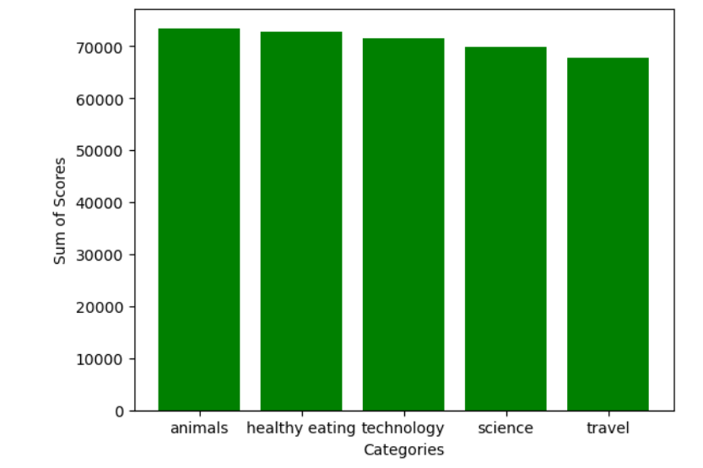
Bar Plot

Slide 9
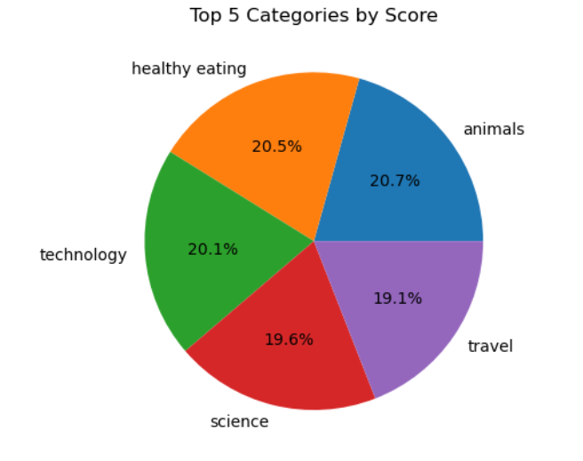
Pie chart

Slide 10

Top op Performing Category: "Animals" leads with the highest score of 73,448, indicating it is the most engaging or effective category based on user reactions.
Close Competitors: "Healthy Eating" and "Technology" follow closely, with scores of 72,727 and 71,612, respectively. These categories also perform well and contribute significantly to the overall engagement.
Trailing Categories: "Science" and "Travel" have lower scores compared to the top three, with scores of 69,823 and 67,808, respectively.
Summary

Slide 11
Thank you!
ANY QUESTIONS?

